Slide 1

Modern Trends with AI Technologies in 2025
Exploring the transformative wave of artificial intelligence reshaping our world

Slide 2






The AI Revolution: From Novelty to Necessity
700%
74%
3pts
Search Growth
Enterprise Adoption
Productivity Gain
Surge in generative AI searches from 2022 to 2023 according to McKinsey research
Organizations have deployed generative AI use cases according to Gallup/ETR 2024
Improvement in white-collar worker productivity driven by AI adoption per IDC/Bloomberg
The artificial intelligence landscape has evolved from experimental technology to business-critical infrastructure, fundamentally changing how organizations operate and compete.

Slide 3





Generative AI: Expanding Capabilities and Applications
Massive Context Windows
Large language models have dramatically expanded their context windows from 100K to 2 million tokens between 2023-24, enabling unprecedented understanding of complex, lengthy documents and conversations.
Multimodal Processing
Modern AI systems seamlessly process text, images, audio, and video simultaneously, creating richer, more intuitive user experiences across platforms.
Customer Chatbots
Ad Generation
Intelligent conversational AI delivering personalized customer support
Automated creation of compelling marketing content and campaigns
Drug Discovery
Creative Content
Accelerated pharmaceutical research and development processes
AI-powered tools for artistic and creative expression

Slide 4




The Rise of Agentic AI: AI That Acts Autonomously
2025 marks a pivotal shift from AI as an assistant to AI as an autonomous agent. These intelligent systems don't just respond to requests—they proactively work toward achieving complex goals.
Goal-Oriented Action
AI agents that help achieve objectives, not just complete individual tasks
Complex Workflows
Managing intricate processes from HR queries to supply chain management
Strategic Transformation
Businesses evolving from productivity tools to transformative decision-making aids

Slide 5

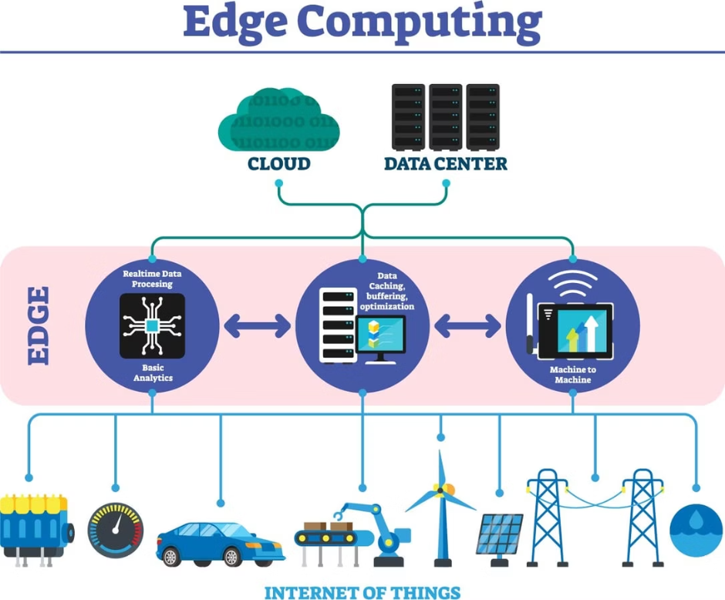
AI Reasoning and Custom Silicon: Powering Smarter AI
Human-Like Logic
AI reasoning capabilities enable models to solve complex problems using human-like logical processes, marking a significant leap from pattern recognition to genuine understanding.
Specialized Hardware
Custom silicon chips (ASICs) designed specifically for AI workloads dramatically improve efficiency and performance while reducing energy consumption.
Edge AI Growth
Real-time processing demands drive adoption of specialized hardware, bringing AI capabilities directly to devices and reducing latency.

Slide 6








Multimodal AI: The Future of Intuitive Interaction
Visual Analysis
Text Generation
Processing and understanding images, charts, and visual data
Creating written content, reports, and documentation
Video Understanding
Voice Conversations
Analyzing motion, context, and temporal information
Natural speech interaction and audio processing
AI systems now integrate multiple data types for richer understanding and output, as noted by Stanford HAI. This integration enhances accessibility and personalization in AI-powered applications, creating more natural and intuitive user experiences.

Slide 7
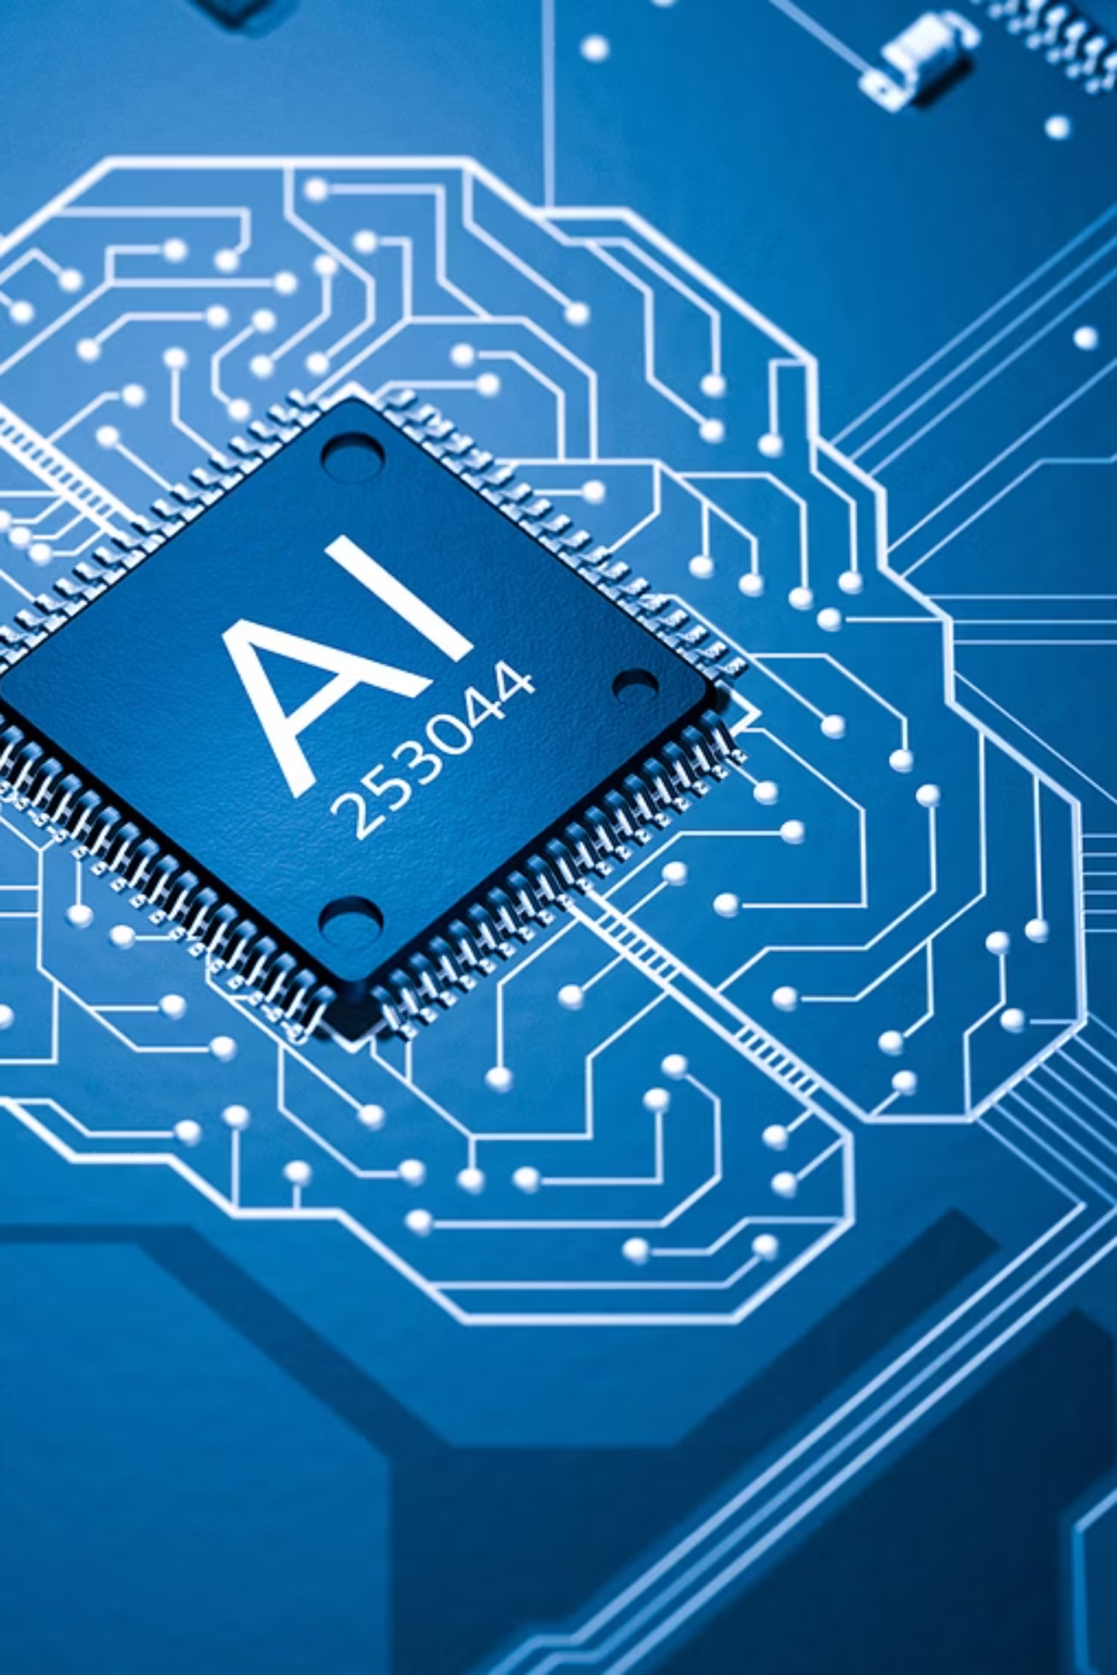
Industry Adoption & Strategic Importance
Market Growth
AGI Race
AI market projected to exceed $800 billion by 2030 according to Statista projections
Governments and corporations competing to develop Artificial General Intelligence
Startup Leadership
81% startup adoption vs. 61% large enterprises driving innovation forward
The competitive landscape reveals that smaller, more agile organizations are leading AI adoption, while the race for AGI intensifies among global technology leaders.

Slide 8
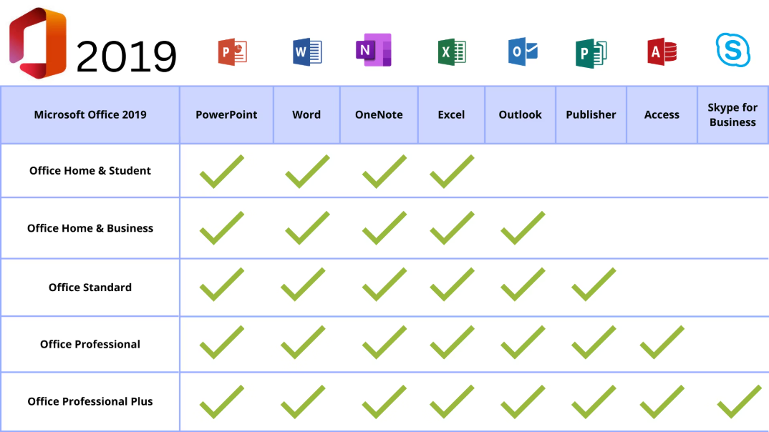

AI in Everyday Life and Business
Workplace Integration
Nearly 70% of Fortune 500 workers use AI tools like Microsoft 365 Copilot for routine tasks, fundamentally changing how business gets done.
Consumer Innovation
AI-powered drawing assist tools and creative aids are entering consumer devices, with features like Samsung One UI 7 democratizing creative capabilities.
01
02
03
Task Automation
Process Management
Creative Enhancement
AI handles routine administrative work, freeing human creativity
Autonomous agents manage complex business workflows end-to-end
AI augments human creativity with intelligent assistance tools

Slide 9
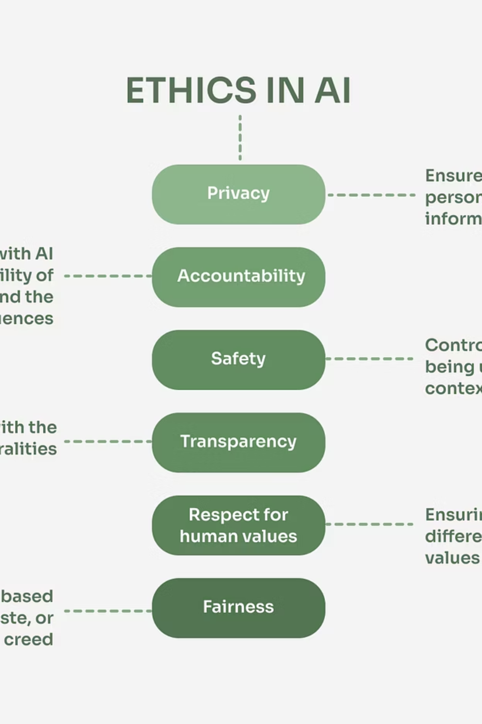
Challenges and Ethical Considerations
Energy Sustainability
Transparency Imperative
Energy demands and efficient computing remain critical for sustainable AI growth, requiring innovative cooling and processing solutions.
AI explainability and transparency are becoming key innovation currencies as stakeholders demand accountability.
Ethical Debates
Concerns over AI neutrality and misuse spark ongoing debates, highlighted by controversies like Elon Musk's Grok chatbot.
As AI becomes more powerful and pervasive, addressing these challenges becomes essential for sustainable and responsible development.

Slide 10

The Future is Now
Strategic Imperative
Rapid Evolution
Investment Priority
AI is no longer optional—it's essential for competitive advantage in the modern economy
From generative AI to agentic AI, technology advances are reshaping entire industries at unprecedented speed
Leaders must invest in talent, infrastructure, and ethical frameworks to harness AI's transformative potential
The AI-powered future is here — are you ready to lead the change?

